Slide 1
回退N

Slide 2
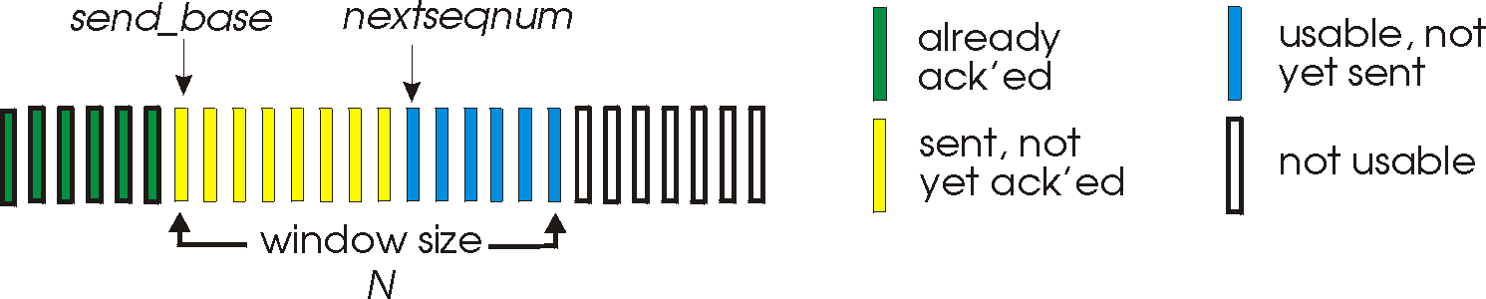
Go-Back-N
Sender:
k-bit seq # in pkt header
“window” of up to N, consecutive unack’ed pkts allowed
ACK(n): ACKs all pkts up to, including seq # n - “cumulative ACK”
may receive duplicate ACKs (see receiver)
timer for each in-flight pkt
timeout(n): retransmit pkt n and all higher seq # pkts in window

Slide 3
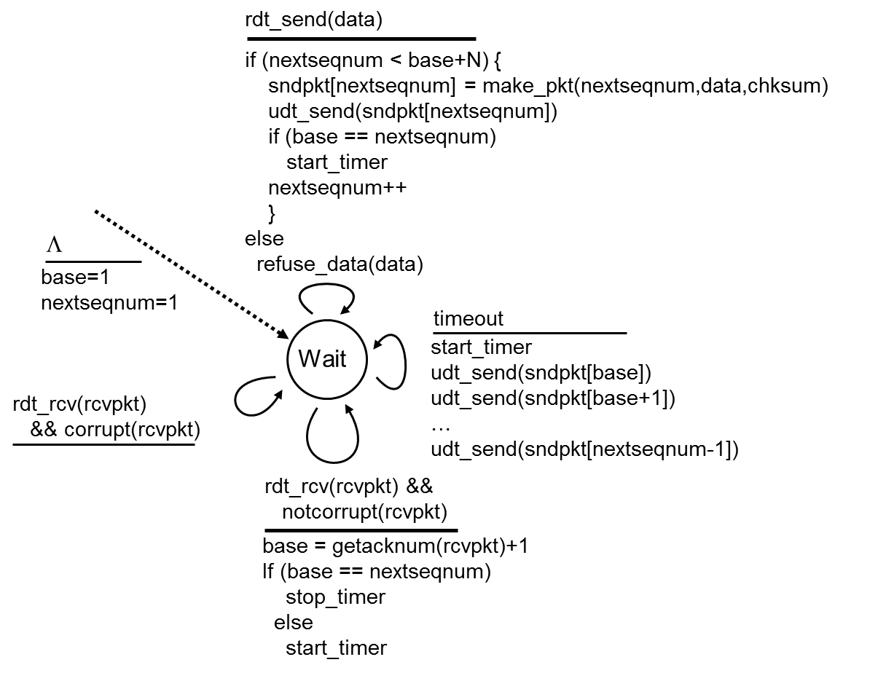
GBN: sender extended FSM

Slide 4
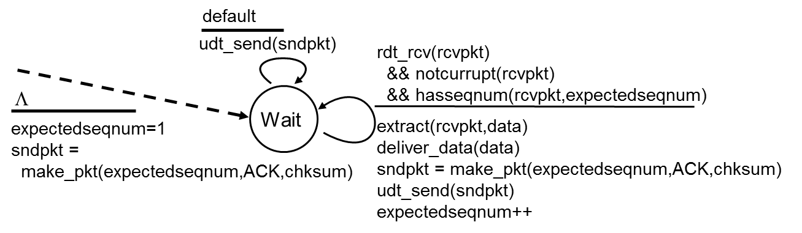
GBN: receiver extended FSM
ACK-only: always send ACK for correctly-received pkt with highest in-order seq #
may generate duplicate ACKs
need only remember expectedseqnum
out-of-order pkt:
discard (don’t buffer) -> no receiver buffering !
Re-ACK pkt with highest in-order seq #

Slide 5
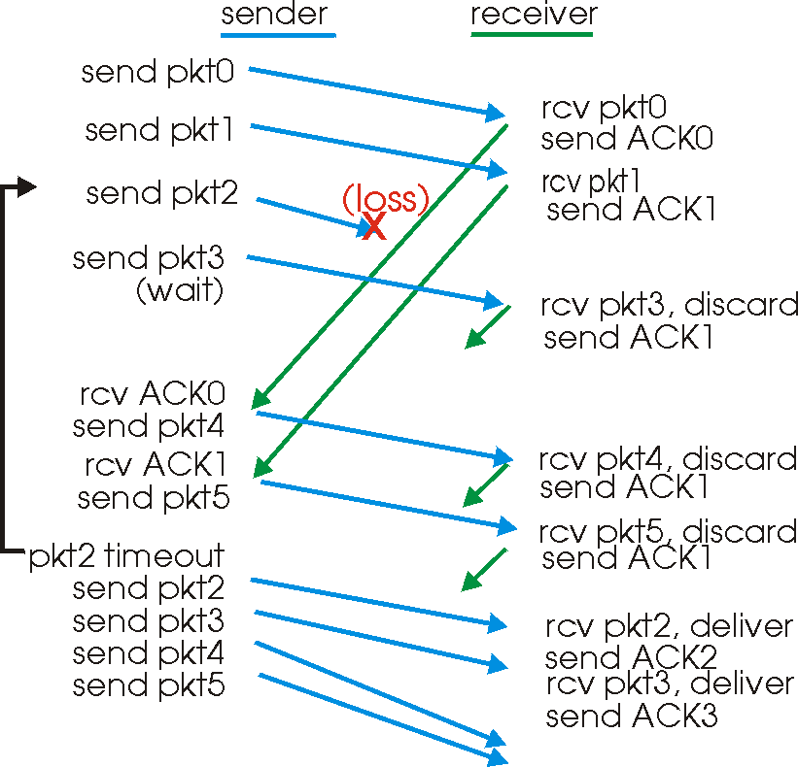
GBN in action

Slide 6

Summary
What’s Go-Back-N

